Slide 1
Data analytics presentation 16:540:507:01 DATA ANALY ENG SYST
Steel Plate Defect Prediction
Balaji sai Tolapu

Slide 2

Content
INTRODUCTION
DATASET COLUMNS
PREPROCESSING
EDA
FEATURE ENGINEERING
DATA TRANSFORMS
MODEL TRAINING
RESULT AND DISCUSSION
CONCLUSION
FUTURE WORK PLANNING

Slide 3
Introduction
The primary objective of the evaluation is to assess the predictive accuracy of the model in distinguishing between different classes of defects. The metric used for this purpose is the Area Under the Receiver Operating Characteristic (ROC)Curve (AUC), which provides a comprehensive measure of the model’s abilityto discriminate between the positive and negative classes across all possible threshold values.
The AUC metric, particularly when averaged across multiple categories, pro-vides a robust and balanced measure of model performance in multi-class clas-sification scenarios. This approach rewards models that maintain good per-formance across all categories, aligning well with the practical requirements ofdefect detection systems where missing any type of defect could be costly.

Slide 4
Evaluation Metrics
The evaluation involves the following steps:
1. Probability Estimates: The model is required to output probabilityestimates for each defect category for every observation in the test set.These probabilities indicate the likelihood of each observation belongingto each of the defect categories.
2. ROC Curve Construction: For each defect category, a ROC curve isconstructed. This curve plots the True Positive Rate (TPR) against theFalse Positive Rate (FPR) at various threshold settings.
3. AUC Calculation: The area under each ROC curve is calculated, pro-viding a single scalar value between 0 and 1 that summarizes the effec-tiveness of the model’s predictions for that category. An AUC of 1.0represents perfect discrimination, while an AUC of 0.5 suggests no dis-criminative power

Slide 5

Final Score Calculation
To derive a final score for the model, the AUC values calculated for each of the7 defect categories are averaged. The formula for the final score is given by:
where AUCi is the area under the ROC curve for the i-th defect category
The use of AUC as an evaluation metric allows for a balanced assessment ofthe model’s performance, taking into account both the sensitivity (ability todetect positives) and specificity (ability to avoid false alarms). By averagingthe AUCs across multiple defect categories, the metric ensures that the modelis consistently performing well across all types of defects rather than beingbiased towards any particular type.

Slide 6
Little knowledge about data
Steel Plates Faults Dataset Features
Feature Category | Feature | Description
Location Features | X_Minimum | Minimum x-coordinate of the fault
 | X_Maximum | Maximum x-coordinate of the fault
 | Y_Minimum | Minimum y-coordinate of the fault
 | Y_Maximum | Maximum y-coordinate of the fault
Size Features | Pixels_Areas | Area of the fault in pixels
 | X_Perimeter | Perimeter along the x-axis of the fault
 | Y_Perimeter | Perimeter along the y-axis of the fault
Luminosity Features | Sum_of_Luminosity | Sum of luminosity values in the fault area
 | Minimum_of_Luminosity | Minimum luminosity value in the fault area
 | Maximum_of_Luminosity | Maximum luminosity value in the fault area
Material and Index Features | TypeOfSteel_A300 | Type of steel (A300)
 | TypeOfSteel_A400 | Type of steel (A400)
 | Steel_Plate_Thickness | Thickness of the steel plate
 | Edges_Index | Index related to edges
 | Empty_Index | Index indicating the presence of empty areas
 | Square_Index | Index measuring squareness of the fault
 | Outside_X_Index | Index measuring alignment along the x-axis
 | Edges_X_Index | Index measuring alignment along edges parallel to the x-axis
 | Edges_Y_Index | Index measuring alignment along edges parallel to the y-axis
Logarithmic Features | LogOfAreas | Logarithm of the area of the fault
 | Log_X_Index | Logarithmic index related to the X coordinate
 | Log_Y_Index | Logarithmic index related to the Y coordinate
Statistical Features | Orientation_Index | Index describing orientation
 | Luminosity_Index | Index related to luminosity
 | SigmoidOfAreas | Sigmoid function applied to areas

Slide 7
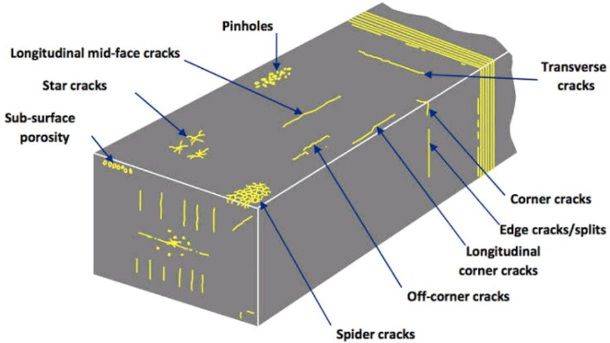
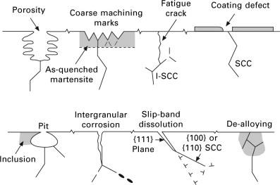
Detailed descriptions here are various types of faults found on steel plates, as identified in quality control processes. Each fault type is discussed in terms of its characteristics and potential implications for steel plate usability.
Pastry
Pastry faults refer to small patches or irregularities on the surface of steel plates,
typically arising from imperfections in the manufacturing process or handling
during transportation. These imperfections can adversely affect the surface
smoothness and visual quality of the plates.
Z-Scratch
Z-Scratches are narrow, elongated marks that run parallel to the rolling direction
of steel plates. These are often caused by handling issues, machining errors, or
contact with abrasive materials during the production or transportation phases.
K-Scratch
Similar to Z-Scratches, K-Scratches run perpendicular to the rolling direction
and can also result from similar causative factors, including handling mishaps
and interactions with abrasive materials

Slide 8
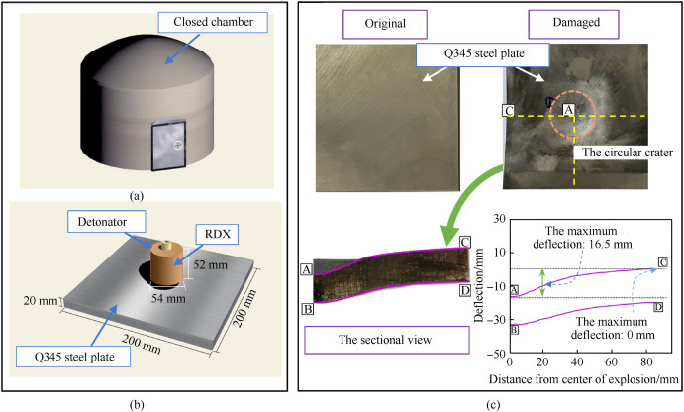

Stains
Stains on steel plates manifest as discolored or contaminated areas, typically
caused by rust, oil, grease, or other foreign substances. These stains can occur
during processing, storage, or handling, and significantly degrade the visual and
structural quality of the steel.
Dirtiness
Dirtiness indicates the presence of dirt or particulate matter on the surface of
steel plates, usually due to inadequate handling or storage conditions. This type
of contamination can affect the plate’s surface quality and its performance in
applications.
Bumps
Bumps are raised or protruding areas on the surface of steel plates, often caused
by anomalies in manufacturing processes such as uneven rolling or improper
cooling. Physical damage during transport or handling can also lead to bumps.
Other Faults
This category includes a variety of faults not specifically classified under the
other types. It encompasses various forms of surface imperfections, irregularities,
and abnormalities that affect the quality or usability of the steel plates.
These faults are identified during quality control inspections to ensure compliance
with required standards.

Slide 9
Sample Steel Plates Faults Training Data
X_Minimum | X_Maximum | Y_Minimum | Y_Maximum | Pixels_Areas | X_Perimeter | Y_Perimeter | Sum_of_Luminosity | Minimum_of_Luminosity | Maximum_of_Luminosity | Length_of_Conveyer | TypeOfSteel_A300 | TypeOfSteel_A400 | Steel_Plate_Thickness | Edges_Index | Empty_Index | Square_Index | Outside_X_Index | Edges_X_Index | Edges_Y_Index | Outside_Global_Index | LogOfAreas | Log_X_Index | Log_Y_Index | Orientation_Index | Luminosity_Index | SigmoidOfAreas | Pastry | Z_Scratch | K_Scatch | Stains | Dirtiness | Bumps | Other_Faults | Target
42 | 50 | 270900 | 270944 | 267 | 17 | 44 | 24220 | 76 | 108 | 1687 | 1 | 0 | 80 | 0.0498 | 0.2415 | 0.1818 | 0.0047 | 0.4706 | 1.0000 | 1.0 | 2.4265 | 0.9031 | 1.6435 | 0.8182 | -0.2913 | 0.5822 | 1 | 0 | 0 | 0 | 0 | 0 | 0 | Pastry
645 | 651 | 2538079 | 2538108 | 108 | 10 | 30 | 11397 | 84 | 123 | 1687 | 1 | 0 | 80 | 0.7647 | 0.3793 | 0.2069 | 0.0036 | 0.6000 | 0.9667 | 1.0 | 2.0334 | 0.7782 | 1.4624 | 0.7931 | -0.1756 | 0.2984 | 1 | 0 | 0 | 0 | 0 | 0 | 0 | Pastry
829 | 835 | 1553913 | 1553931 | 71 | 8 | 19 | 7972 | 99 | 125 | 1623 | 1 | 0 | 100 | 0.9710 | 0.3426 | 0.3333 | 0.0037 | 0.7500 | 0.9474 | 1.0 | 1.8513 | 0.7782 | 1.2553 | 0.6667 | -0.1228 | 0.2150 | 1 | 0 | 0 | 0 | 0 | 0 | 0 | Pastry
853 | 860 | 369370 | 369415 | 176 | 13 | 45 | 18996 | 99 | 126 | 1353 | 0 | 1 | 290 | 0.7287 | 0.4413 | 0.1556 | 0.0052 | 0.5385 | 1.0000 | 1.0 | 2.2455 | 0.8451 | 1.6532 | 0.8444 | -0.1568 | 0.5212 | 1 | 0 | 0 | 0 | 0 | 0 | 0 | Pastry
1289 | 1306 | 498078 | 498335 | 2409 | 60 | 260 | 246930 | 37 | 126 | 1353 | 0 | 1 | 185 | 0.0695 | 0.4486 | 0.0662 | 0.0126 | 0.2833 | 0.9885 | 1.0 | 3.3818 | 1.2305 | 2.4099 | 0.9338 | -0.1992 | 1.0000 | 1 | 0 | 0 | 0 | 0 | 0 | 0 | Pastry
Sample Steel Plates Faults Test Data
X_Minimum | X_Maximum | Y_Minimum | Y_Maximum | Pixels_Areas | X_Perimeter | Y_Perimeter | Sum_of_Luminosity | Minimum_of_Luminosity | Maximum_of_Luminosity | Length_of_Conveyer | TypeOfSteel_A300 | TypeOfSteel_A400 | Steel_Plate_Thickness | Edges_Index | Empty_Index | Square_Index | Outside_X_Index | Edges_X_Index | Edges_Y_Index | Outside_Global_Index | LogOfAreas | Log_X_Index | Log_Y_Index | Orientation_Index | Luminosity_Index | SigmoidOfAreas | Pastry | Z_Scratch | K_Scatch | Stains | Dirtiness | Bumps | Other_Faults | Target
42 | 50 | 270900 | 270944 | 267 | 17 | 44 | 24220 | 76 | 108 | 1687 | 1 | 0 | 80 | 0.0498 | 0.2415 | 0.1818 | 0.0047 | 0.4706 | 1.0000 | 1.0 | 2.4265 | 0.9031 | 1.6435 | 0.8182 | -0.2913 | 0.5822 | 1 | 0 | 0 | 0 | 0 | 0 | 0 | Pastry
645 | 651 | 2538079 | 2538108 | 108 | 10 | 30 | 11397 | 84 | 123 | 1687 | 1 | 0 | 80 | 0.7647 | 0.3793 | 0.2069 | 0.0036 | 0.6000 | 0.9667 | 1.0 | 2.0334 | 0.7782 | 1.4624 | 0.7931 | -0.1756 | 0.2984 | 1 | 0 | 0 | 0 | 0 | 0 | 0 | Pastry
829 | 835 | 1553913 | 1553931 | 71 | 8 | 19 | 7972 | 99 | 125 | 1623 | 1 | 0 | 100 | 0.9710 | 0.3426 | 0.3333 | 0.0037 | 0.7500 | 0.9474 | 1.0 | 1.8513 | 0.7782 | 1.2553 | 0.6667 | -0.1228 | 0.2150 | 1 | 0 | 0 | 0 | 0 | 0 | 0 | Pastry
853 | 860 | 369370 | 369415 | 176 | 13 | 45 | 18996 | 99 | 126 | 1353 | 0 | 1 | 290 | 0.7287 | 0.4413 | 0.1556 | 0.0052 | 0.5385 | 1.0000 | 1.0 | 2.2455 | 0.8451 | 1.6532 | 0.8444 | -0.1568 | 0.5212 | 1 | 0 | 0 | 0 | 0 | 0 | 0 | Pastry
1289 | 1306 | 498078 | 498335 | 2409 | 60 | 260 | 246930 | 37 | 126 | 1353 | 0 | 1 | 185 | 0.0695 | 0.4486 | 0.0662 | 0.0126 | 0.2833 | 0.9885 | 1.0 | 3.3818 | 1.2305 | 2.4099 | 0.9338 | -0.1992 | 1.0000 | 1 | 0 | 0 | 0 | 0 | 0 | 0 | Pastry
Training Data: Number of Rows: 21160 Number of Columns: 35 Test Data: Number of Rows: 12814 Number of Columns: 28 Submission Data: Number of Rows: 12814 Number of Columns: 8

Slide 10
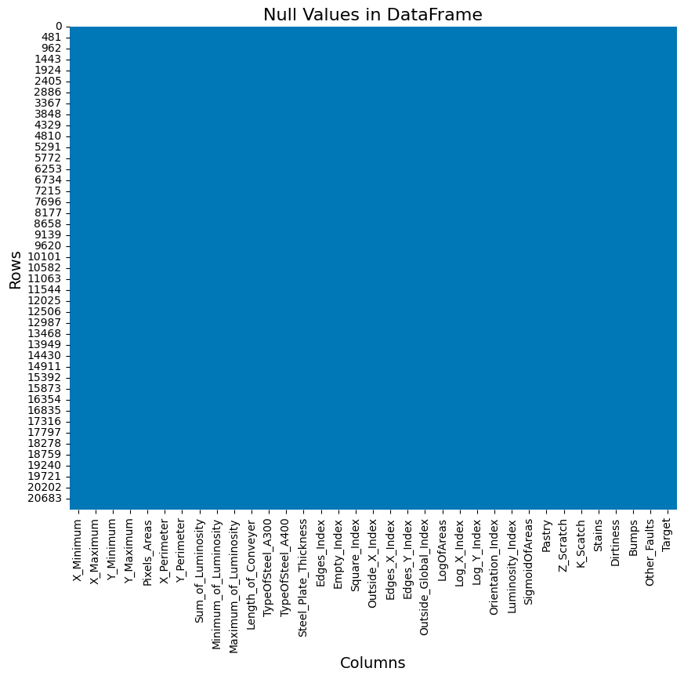
Data cleaning and preparing
Null values :
Null Count in Train: 0 Null Count in Test: 0 Null Count in Submission: 0
Duplicates:
Number of duplicate rows in train_data: 0 Number of duplicate rows itest_data: 0 Number of duplicate rows in test_data: 0
Data statistics :
Measure | X_Minimum | X_Maximum | Y_Minimum | Y_Maximum | Pixels_Areas | X_Perimeter | Y_Perimeter | Sum_of_Luminosity | Minimum_of_Luminosity | Maximum_of_Luminosity | Length_of_Conveyer | TypeOfSteel_A300 | TypeOfSteel_A400 | Steel_Plate_Thickness | Edges_Index | Empty_Index | Square_Index | Outside_X_Index | Edges_X_Index | Edges_Y_Index | Outside_Global_Index | LogOfAreas | Log_X_Index | Log_Y_Index | Orientation_Index | Luminosity_Index | SigmoidOfAreas | Pastry | Z_Scratch | K_Scatch | Stains | Dirtiness | Bumps | Other_Faults
Count | 21160 | 21160 | 21160 | 21160 | 21160 | 21160 | 21160 | 21160 | 21160 | 21160 | 21160 | 21160 | 21160 | 21160 | 21160 | 21160 | 21160 | 21160 | 21160 | 21160 | 21160 | 21160 | 21160 | 21160 | 21160 | 21160 | 21160 | 21160 | 21160 | 21160 | 21160 | 21160 | 21160 | 21160
Mean | 697.130057 | 741.392202 | 1831495 | 1828639 | 1703.24 | 97.14 | 65.85 | 193173.6 | 84.78 | 128.79 | 1459.33 | 0.402457 | 0.596645 | 76.44 | 0.350992 | 0.409758 | 0.574176 | 0.030862 | 0.614362 | 0.829984 | 0.590416 | 2.47521 | 1.314778 | 1.390978 | 0.100958 | -0.137733 | 0.573142 | 0.076749 | 0.063327 | 0.180671 | 0.030246 | 0.025520 | 0.244093 | 0.341730

Slide 11
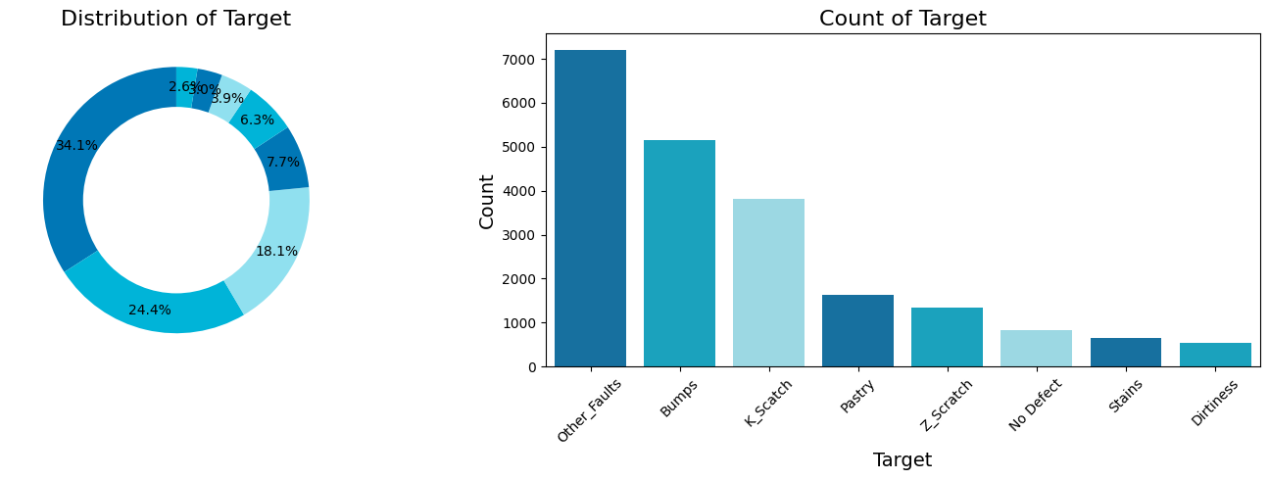
EDA (Explorartary Data Analysis)

Slide 12
The dataset includes several fault categories, each representing different challenges and frequencies.
Other Faults, with 7,213 instances, constitutes a sig-nificant portion of the dataset, highlighting its prominence and suggesting a di-verse range of faults that are not classified under more specific categories. Thisdiversity may present challenges in model training due to the heterogeneity ofthe faults.
Bumps are noted in 5,163 instances and represent another majorfault category, albeit slightly less frequent than Other Faults. The considerablepresence of bumps underscores the importance of robust feature recognition bypredictive models to differentiate these faults effectively.
K Scatch, with 3,822 instances, forms a substantial part of the datasetand is critical in classification tasks, indicating that distinguishing this faulttype effectively is crucial for achieving high accuracy

Slide 13
Z Scratch andStains, with 1,340 and 640 instances respectively, represent smaller segmentsof the dataset, emphasizing the need for models to also focus on less frequentfault types to ensure comprehensive classification coverage.The dataset also includes 818 instances labeled as No Defect, which isrelatively minor compared to other categories but crucial for understanding thedataset’s overall quality.
Similarly, Dirtiness, found in 540 instances, thoughinfrequent, points to specific contamination faults that are essential to recognizefor maintaining high-quality standards in steel plate production.
Pastry faults are lesscommon, with 1,624 instances, suggesting that while they are less prevalent,their recognition is still important for detailed fault analysis.

Slide 14
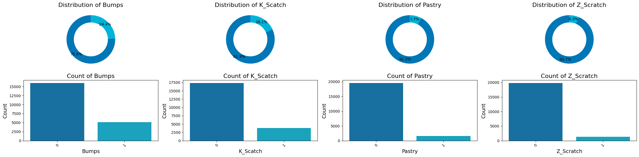
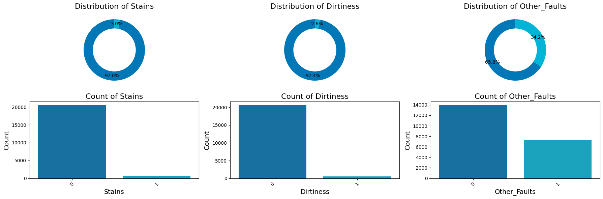

Slide 15
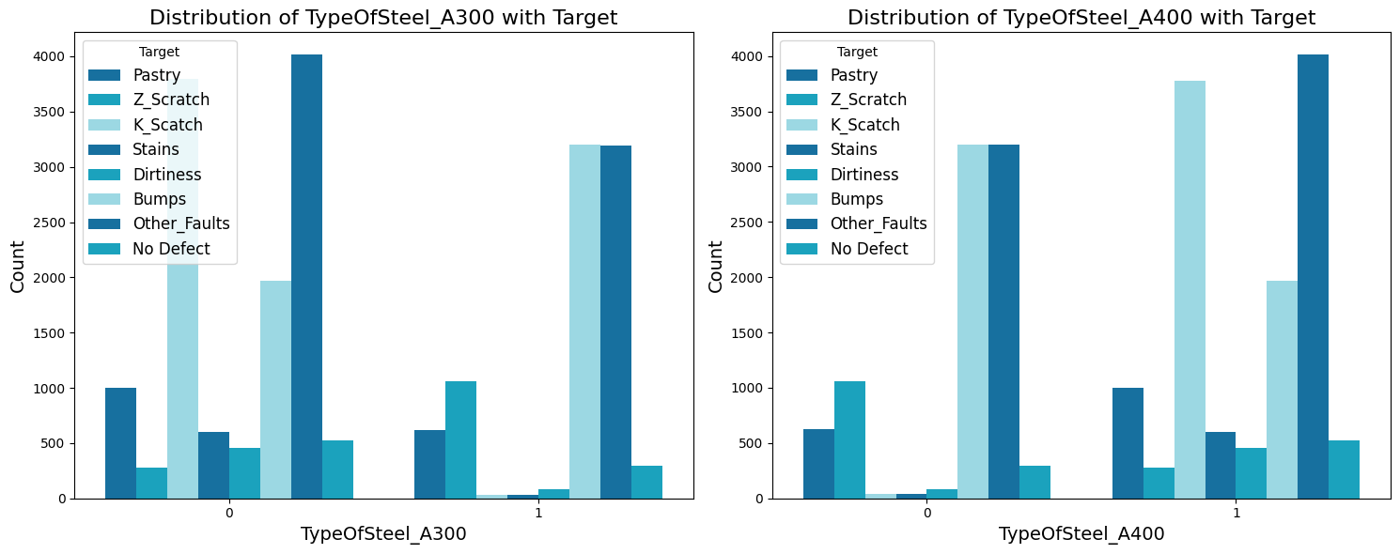
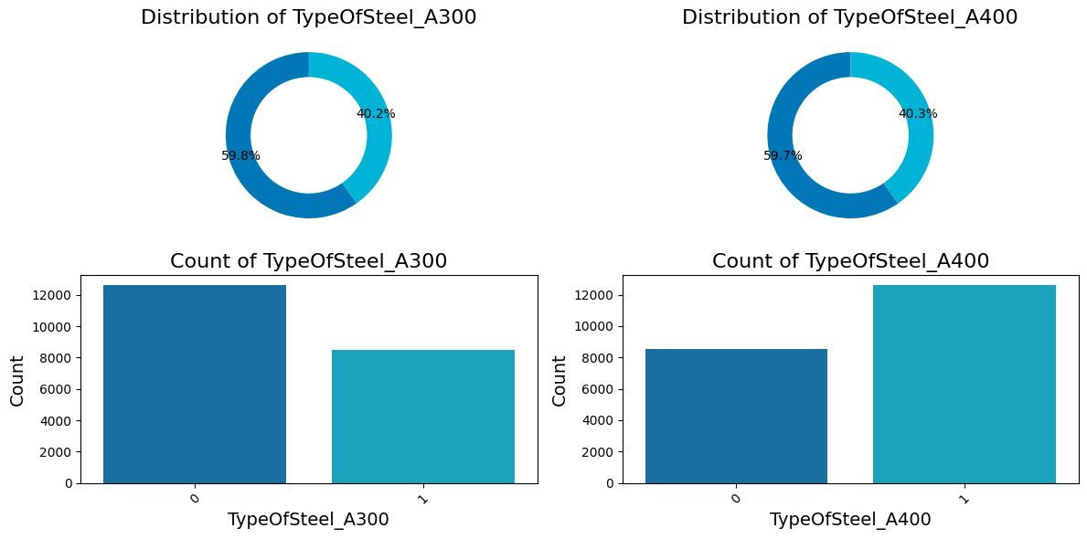

Slide 16
Fault Analysis Common FaultsWe categorize the faults into several types, each representing a specific defectin the production line.
PastryAs shown in the chart, 92.3% of instances do not have the Pastry fault, indicatingeffective control measures against this type of defect.
Z ScratchThe data reveals that 93.7% of samples are free from Z Scratch faults, highlight-ing successful prevention strategies in current quality management practices.
K ScatchK Scatch faults are more prevalent, with 18.1% of items affected. This suggestsa potential area for improvement in detecting and preventing these faults duringproduction.

Slide 17
BumpsApproximately 24.4% of products have Bumps faults, making this a commonissue that requires targeted interventions to reduce occurrence.
Stains, Dirtiness, and Other Faults These plots illustrate that while Stains and Dirtiness are relatively rare (affecting3% and 2.5% of products, respectively), Other Faults are more frequent andvaried, affecting 34.2% of products.
The analysis indicates that while certain faults such as Pastry and Z Scratch arewell controlled, other areas like K Scatch and Bumps need further investigationand improvement. Ongoing efforts to monitor and reduce all types of faults arecrucial for maintaining high standards of product quality.

Slide 18
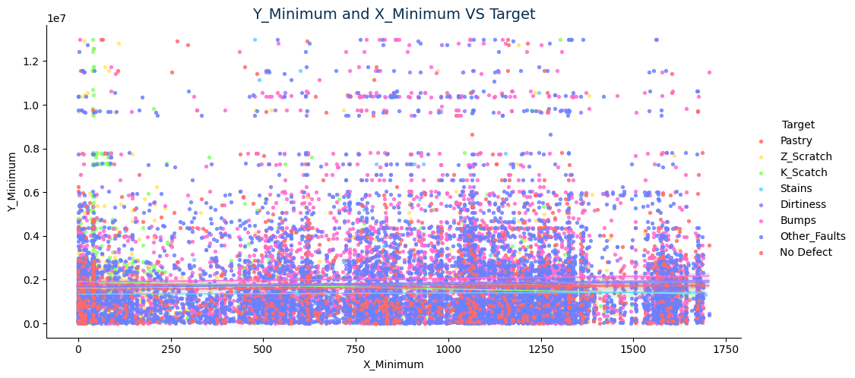
Scatter plot - Y Minimum and X Minimum vs. Target:

Slide 19
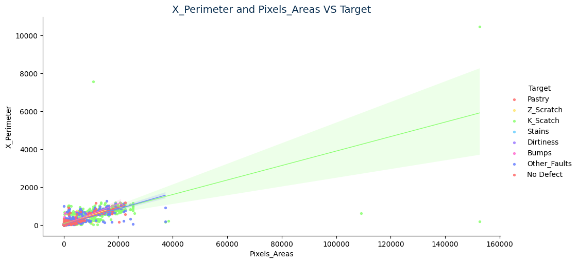
X Perimeter and Pixels Areas vs. Target:

Slide 20
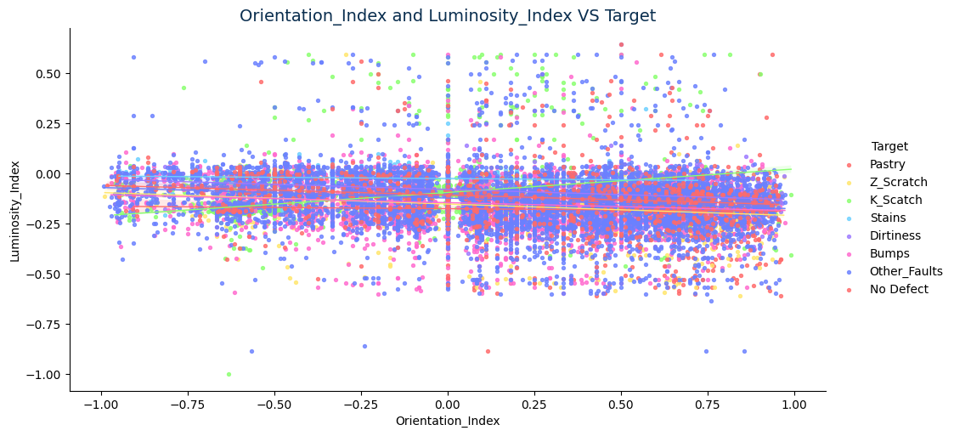
Orientation Index and Luminosity Index vs. Target:

Slide 21
Plot Insights
• Y Minimum and X Minimum vs. Target: This scatter plot visual-izes the distribution of faults based on the minimum Y and X coordinatesof the defects. Most of the data points, regardless of defect type, are clus-tered around lower values of Y and X, indicating that faults are frequentlyoccurring closer to the origin of the steel plates. There is no clear separa-tion between different types of faults, suggesting that spatial coordinatesalone might not be sufficient to classify defects effectively.
• X Perimeter and Pixels Areas vs. Target: A trend analysis inthis plot shows a positive correlation between pixel area and perimetersize, which is expected as larger defects typically encompass a greaterperimeter. The green confidence band highlights this relationship andshows a consistent increase in perimeter as pixel area increases, across alldefect types. This implies that pixel area can be a strong indicator of thesize of the defect but less about the type of defect.

Slide 22
Orientation Index and Luminosity Index vs. Target: This plotshows the spread of defect types against the orientation and luminosityindices. Most defects types are dispersed across a narrow range of lumi-nosity but vary more widely in orientation, suggesting that the angle atwhich the defects lie on the surface of the steel might vary more than theirbrightness or color. However, like other plots, the overlap is significant,indicating complexity in using these features alone to distinguish between defect types.
General Observations -Across all plots, the defect types are not distinctly separable based on the visu-alized features. The overlap in the distributions suggests that a combination offeatures or more sophisticated machine learning models might be necessary toaccurately classify the type of defect. Advanced feature engineering or the in-clusion of additional context-specific attributes could potentially enhance modelperformance.

Slide 23
Numerical Feature Distribution

Slide 25
Plot insights
OverviewThe histograms provide a detailed visualization of the distributions of several features relevant to steel plate defect detection. These features exhibit a range of distribution shapes, skewness, and concentrations of values, indicating varied characteristics and potential challenges in data modeling.
Detailed Observations :
• Gaussian-like Distributions: Some features, such as ’Edges Y Index’,show distributions that are nearly Gaussian, suggesting that these featuresmight be well-modeled by algorithms assuming normality.
• Skewed Distributions: A significant number of features display skew-ness:– Left-Skewed: Features like ’Minimum of Luminosity’ and ’Edges Index’show a concentration of values towards the higher end of the range,with fewer lower values.– Right-Skewed: Conversely, features such as ’Pixels Areas’, ’X Perimeter’,and ’Y Perimeter’ are predominantly skewed towards the lower end,with long tails extending towards higher values.
• High Skewness and Kurtosis: Most features, including ’Orientation Index’and ’Luminosity Index’, are highly skewed, either to the right or left, in-dicating extreme values that could affect model performance.
• Varied Scales and Units: The features also differ significantly in theirscales and units, as evident from the axes of the histograms, which canimpact the performance of machine learning models that are sensitive tofeature magnitude.

Slide 26
Preprocessing Recommendations
Given the diverse nature of the feature distributions:
• Normalization: Applying normalization methods, such as the QuantileTransformer, is recommended to mitigate issues related to skewness andto standardize features onto a similar scale.
• Handling Outliers: Considering the presence of outliers as suggestedby the long tails in skewed distributions, outlier detection and removal orcapping methods should be evaluated.
• Feature Engineering: Generating new features or transforming existingones, such as logarithmic scaling or binning, could help in stabilizing thevariance and making the distributions more symmetric.
The detailed analysis of feature distributions helps in understanding the prepro-cessing needs essential for optimal modeling of steel plate defects. Appropriatehandling of these characteristics through robust preprocessing techniques willbe crucial in developing a predictive model with high accuracy.

Slide 28
Normalization
Introduction to Normalization
Normalization is an essential preprocessing technique in data analysis and ma-chine learning, particularly effective when dealing with features that vary inscale and distribution. The Quantile Transformer is a robust method used tonormalize data by transforming the features to follow a specific statistical dis-tribution. This transformation is crucial for models that are sensitive to thescale of input data, such as linear regression and neural networks.Normalization helps in adjusting the scale of features so that they have amore uniform spread. This is particularly beneficial for algorithms that dependon the distance between data points, as it ensures that all features contributeequally to the result, preventing features with wider ranges from dominatingthe decision process.
Gaussian Distribution
The Gaussian distribution, also known as the normal distribution, is a type of continuous probability distribution for a real-valued random variable. It is sym-metrically distributed around the mean, describing many natural phenomen aand commonly used in statistical practices as a default model for many naturalprocesses.In the context of feature normalization using a Quantile Transformer, trans-forming data to a Gaussian distribution involves mapping the quantiles of thefeature’s empirical distribution to the quantiles of the theoretical Gaussian dis-tribution. This approach is particularly useful because many statistical methodsand machine learning algorithms assume or perform better if the data follows a Gaussian distribution

Slide 29
The histograms above display the distributions of various features from the Steel Plate Faults dataset, transformed to approximate Gaussian distributions using a Quantile Transformer. Each panel represents a different feature, showing the transformed distribution in yellow and the original distribution in blue. This transformation highlights the effectiveness of normalization in making the data more suitable for algorithms that assume normally distributed input.
By transforming feature distributions to be Gaussian, the Quantile Transformer helps in stabilizing variance and normalizing the behavior of outlier values,which enhances the performance of many machine learning algorithms. Such transformations are pivotal in preparing data for sophisticated models, ensuring that each feature contributes optimally to the predictive process.

Slide 30
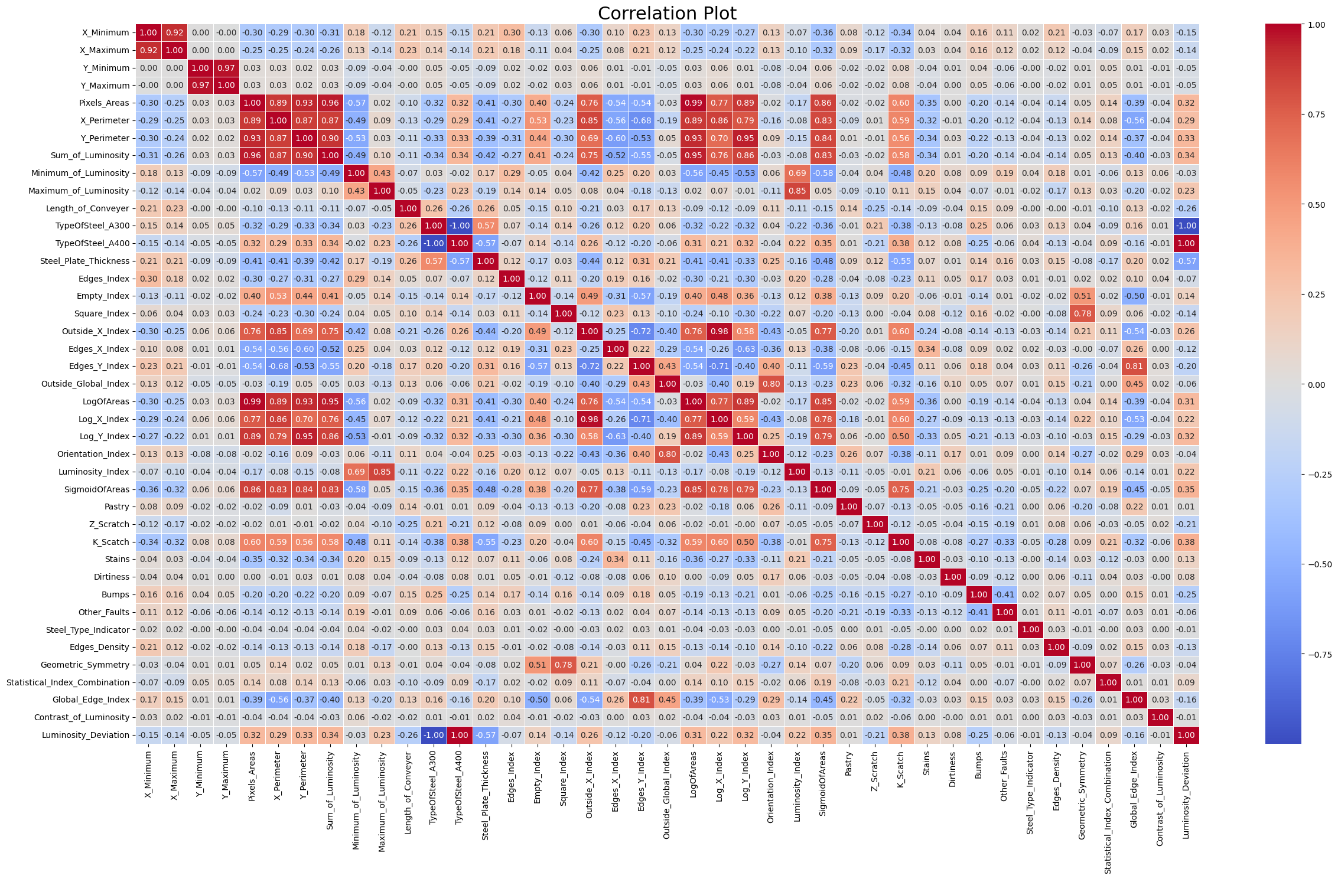

Slide 31
Correlation Plot
In the correlation matrix, it's evident that several feature pairs exhibit strong relationships, both positively and negatively, which could have significant implications for model performance due to multicollinearity. These relationships suggest potential redundancy or direct influence between features that model training processes need to account for.
Insights from the Correlation Matrix:
High Positive Correlations: Features like X_Minimum and X_Maximum exhibit perfect correlation (r=1.00), indicating redundancy. Such pairs may not provide unique information, which could lead to overfitting in machine learning models.
High Negative Correlations: There are instances of strong negative correlations, such as between Pixels_Areas and Outside_Global_Index (r=-0.36), suggesting that as one feature increases, the other decreases, which could be pivotal in understanding the inverse relationships within the data.
Moderate to Weak Correlations: Many features show moderate to weak correlations, which suggests that they could be providing unique information to the models without heavy interdependencies.
Implications for Feature Engineering: The insights from the correlation analysis are crucial for feature engineering, indicating potential candidates for feature selection, transformation, or removal to improve model robustness and performance.

Slide 32
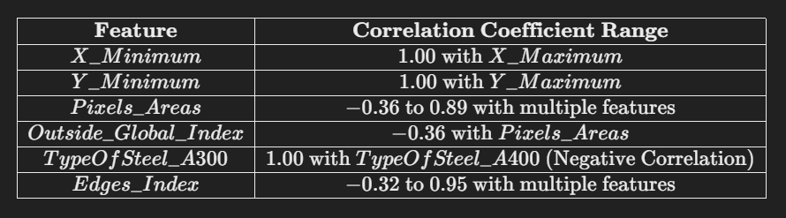
Significant Features Identified: Based on the correlation matrix, here are the significant features that stand out either due to their strong correlations with many other features or due to their unique lack of correlation, suggesting independence and potentially unique predictive power.
Highly Correlated Features: ['X_Maximum', 'Y_Maximum', 'X_Perimeter', 'Y_Perimeter', 'Sum_of_Luminosity', 'Minimum_of_Luminosity', 'TypeOfSteel_A400', 'Steel_Plate_Thickness', 'Empty_Index', 'Outside_X_Index', 'Edges_X_Index', 'Edges_Y_Index', 'LogOfAreas', 'Log_X_Index', 'Log_Y_Index', 'Orientation_Index', 'Luminosity_Index', 'SigmoidOfAreas', 'K_Scatch', 'Geometric_Symmetry', 'Global_Edge_Index', 'Luminosity_Deviation']

Slide 33
Model Building ,training and testing
X_train shape: (19043, 34) X_test shape: (2116, 34) y_train shape: (19043, 7) y_test shape: (2116, 7) The shape of Train data is (21159, 35) The shape of Test data is (12814, 35)
Train Test Split
I tried many models and I am collectively showing all my models ahead.
MODELS TRAINED - initial ( xgboost , catboost , random forest )
using SVM (KERNEL TRICK thanks)
Advanced methodology

Slide 34
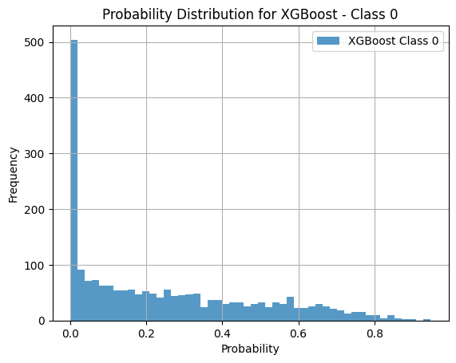
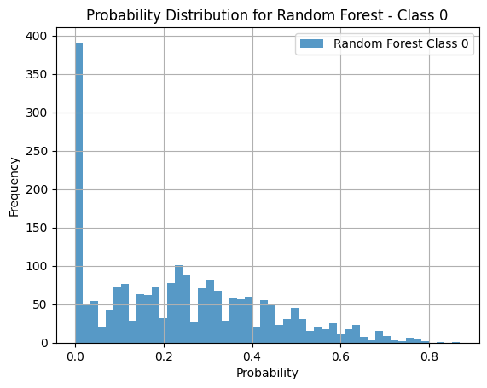
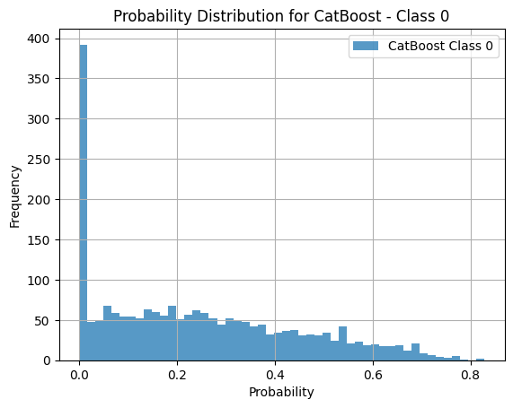
Results and Discussions

Slide 35
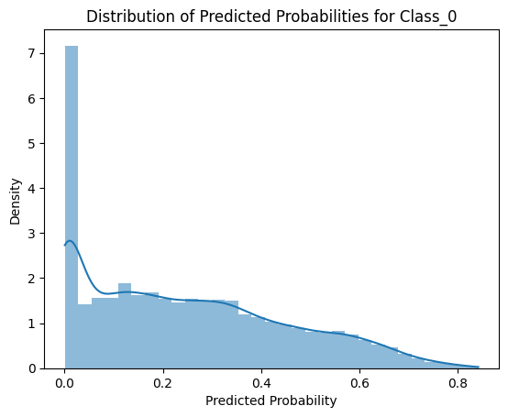
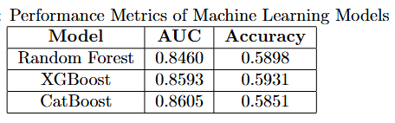
Performance evaluation.

Slide 36
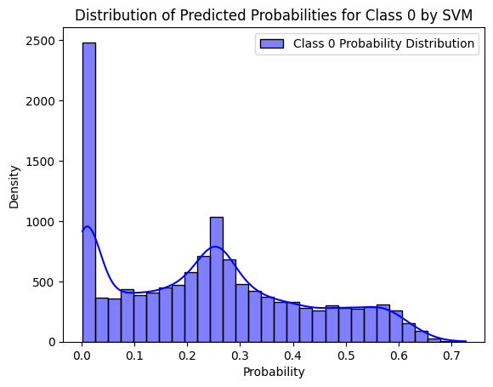
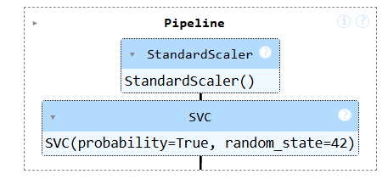
SVM (KERNEL TRICK thanks)
Model | AUC | Accuracy
Random Forest | 0.8460 | 0.5898
XGBoost | 0.8593 | 0.5931
CatBoost | 0.8605 | 0.5851
SVM | 0.8393 | 0.6070
Stacked Model | 0.8481 | 0.5789

Slide 37
Sample predictions
id | Id.no | Pastry | Z_Scratch | K_Scatch | Stains | Dirtiness | Bumps | Other_Faults
0 | 19219 | 0.128816 | 0.011377 | 0.002381 | 0.023300 | 0.260275 | 0.571741 | 0.000533
1 | 19220 | 0.133301 | 0.221684 | 0.010769 | 0.021420 | 0.351337 | 0.244098 | 0.000939
2 | 19221 | 0.319726 | 0.011442 | 0.034958 | 0.089132 | 0.509559 | 0.003524 | 0.001849
3 | 19222 | 0.405960 | 0.009985 | 0.001633 | 0.028166 | 0.390861 | 0.158575 | 0.001492
4 | 19223 | 0.620587 | 0.004565 | 0.001620 | 0.046223 | 0.319608 | 0.003532 | 0.001121

Slide 38
Confusion Matrix for Stacked Model
238 | 0 | 1 | 0 | 245 | 5 | 2 | 9
2 | 6 | 0 | 0 | 38 | 2 | 1 | 1
6 | 1 | 346 | 0 | 33 | 1 | 0 | 0
12 | 1 | 8 | 0 | 48 | 3 | 0 | 3
151 | 3 | 37 | 0 | 487 | 22 | 17 | 32
22 | 4 | 2 | 0 | 92 | 27 | 0 | 0
0 | 0 | 0 | 0 | 11 | 0 | 47 | 0
9 | 0 | 0 | 0 | 67 | 0 | 0 | 74

Slide 39
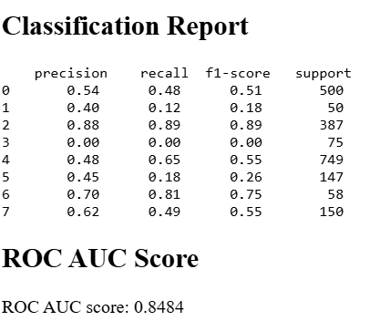

Slide 40
Discussions
The provided plots highlight the probability distributions for the class 0 predictions made by Random Forest, XGBoost, CatBoost, and SVM models, offering insights into the behavior of these models when handling binary classification tasks. Notably:
Random Forest and XGBoost show a significant concentration of predictions at the lower end of the probability scale, particularly at or near zero, indicating a strong confidence in the negative class for a large number of instances. This could suggest a model bias towards the negative class or an underlying pattern within the data that these models are particularly sensitive to.
CatBoost displays a slightly more balanced distribution, though it still shows a predominant focus towards the lower probability values. However, compared to Random Forest and XGBoost, CatBoost has a smoother distribution that extends more evenly into the higher probability ranges.

Slide 41

The SVM, configured within a pipeline incorporating a StandardScaler, exhibits a notably different distribution. The majority of its predictions are also concentrated at the extreme low end of the probability scale, but there's a secondary peak around 0.6. This dual-peak pattern might indicate that the SVM, with its inherent margin maximization, is more decisive in its classification, leading to higher confidence in certain predictions.
The Classification Report and ROC AUC Scores for these models indicate varying levels of effectiveness, with the SVM showing a slightly higher AUC compared to others but with a varied performance across different classes as seen in precision, recall, and F1-scores. The ROC AUC scores being close to or above 0.84 for all models suggests a good predictive performance, albeit with some models handling certain classes better than others.

Slide 42
Conclusion
The analysis of these models on the task reveals that while all models perform relatively well, there are nuances in how they handle classifications. XGBoost and CatBoost, with their gradient boosting frameworks, seem to provide a slight edge in handling the subtleties of the dataset, evidenced by their higher AUC scores. However, the choice of model might depend on the specific requirements of recall, precision, or overall accuracy for particular classes, especially in imbalanced datasets where certain classes are more critical than others. The insights from these probability distributions and classification reports provide valuable guidance for refining model selection and tuning to improve performance further.

Slide 43
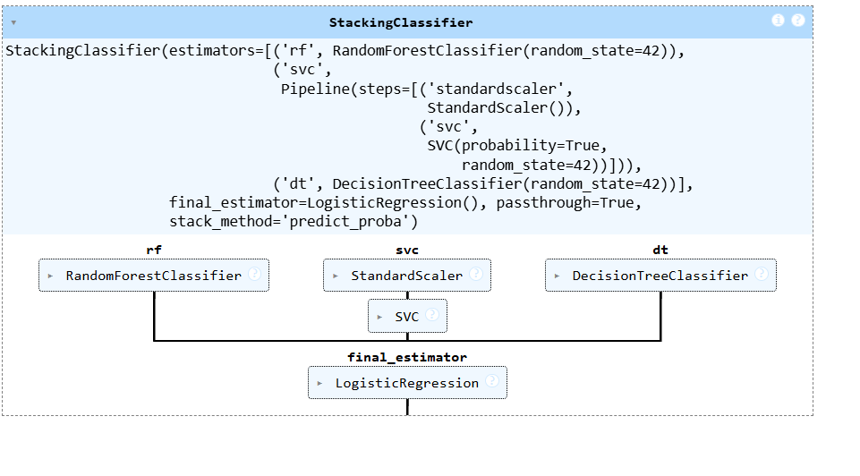
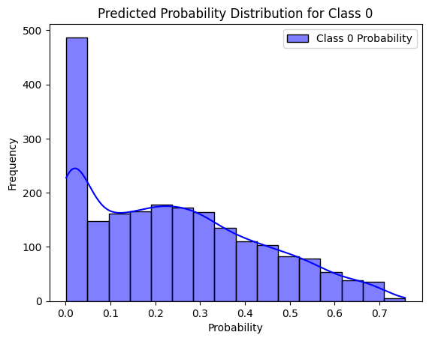
Future Work
Advance methodology
Stacked Model AUC: 0.8481
Working on parameter optimization for better accuracy

